Slide 1
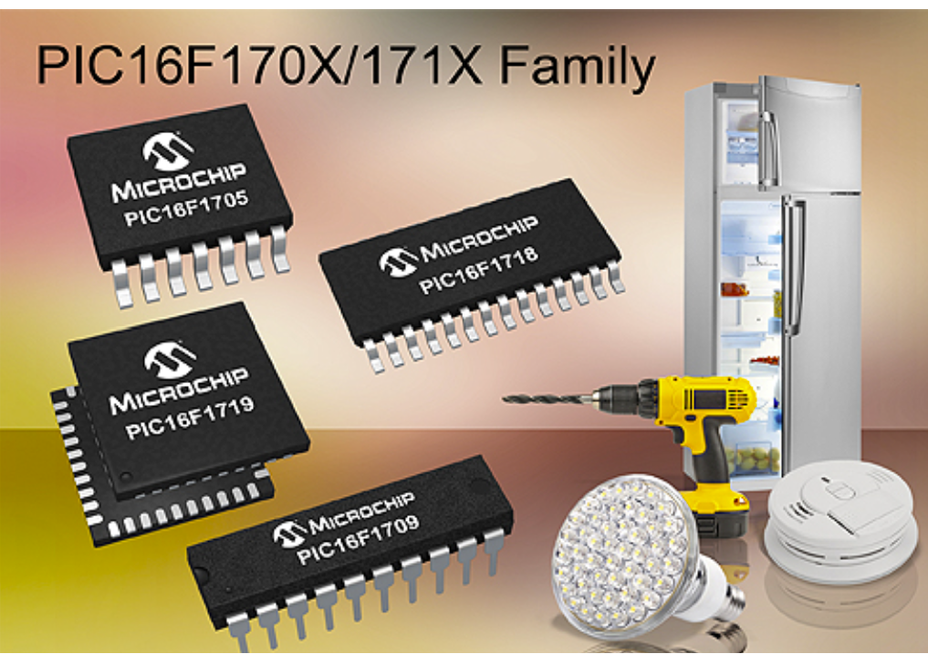
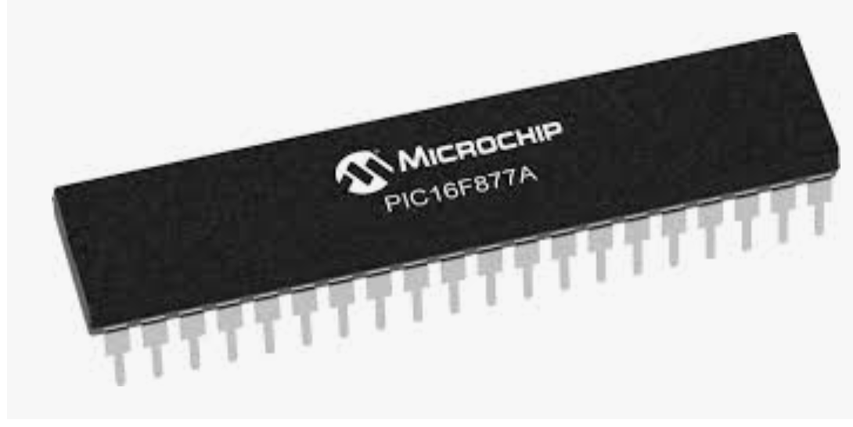
Introducing the PIC Microchip Families
Lecture2

Slide 2
PIC Microcontroller
The “PIC” was originally a design of the company General Instruments. It was intended for simple control applications, hence the name – Peripheral Interface Controller. In the late 1970s General Instruments produced the PIC1650 and PIC 1655 processors. Although the design was comparatively crude and unorthodox, the PIC was completely stand-alone, and contained some important and forward-looking features. The simple CPU was a RISC structure, with a single accumulator (called the “Working Register”, and just 30 instructions. The output pins could source or sink much more current than most other microprocessors of the time. Already the trademarks of the PIC were emerging – simplicity, stand-alone, high speed, and low cost.
General Instruments sold off its semiconductor division to a group of venture capitalists, who must have realised the immense potential of these odd little devices. Throughout the nineties the range of available PIC microcontrollers grew, and as they did so they gradually overtook many of their better-established competitors. In many cases PIC microcontrollers could run faster, needed a simpler chip-set, and were quicker to prototype with, than their competitors. Unlike many competitors, Microchip made their development tools simple, and low-cost or free. Moreover, Microchip stayed firmly entrenched in the 8-bit world.
Despite the huge advances that have been made, we can still see features of the old General Instruments PIC, even in the most recent designs.

Slide 3
A Manufacturer’s Microcontroller Portfolio
Core Q
Memory
Core R
Peripherals
Memory
Peripherals
Core Q
Memory
Peripherals
Core R
Memory
Core Q
Memory
Peripherals
Peripherals
Memory
Memory
Core R
Core Q
Peripherals
Peripherals

Slide 4
The PIC Microchip Families
Family | Example Devices | Instruction word size | Stack size (words) | Number of instructions | Interrupt vectors
Baseline | 10F200, 12F508, 16F57 | 12-bit | 2 | 33 | None
Mid-range | 12F609, 16F84A, 16F631, 16F873A | 14-bit | 8 | 35 | 1
High Performance | 18F242, 18F2420 | 16-bit | 32 | 75, including hardware multiply | 2 (prioritised)

Slide 5
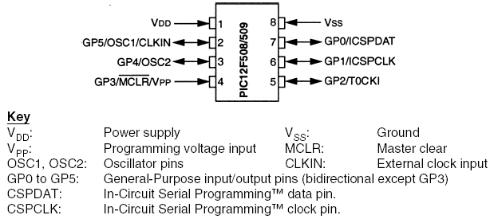
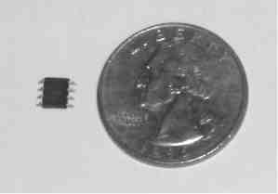
PIC 12F508/509

Slide 6
Some Examples of the Microchip Mid-Range Family
Device number | No. of pins* | Clock speed | Memory (K = Kbytes, i.e. 1024 bytes) | Peripherals/special features
16F84A | 18 | DC to 20MHz | 1K program memory, 68 bytes RAM, 64 bytes EEPROM | 1 8-bit timer, 1 5-bit parallel port, 1 8-bit parallel port, ICSP.
16LF84A | 18 | DC to 20MHz | as above | As above, with extended supply voltage range
16F84A-04 | 18 | DC to 4MHz | as above | As above
16F87 | 18 | DC to 20MHz | 4K program memory, 368 bytes RAM, 256 bytes EEPROM. | 2 parallel ports, 3 counter/timers, 2 capture/compare/PWM modules, 2 serial communication modules, 2 analog comparators, nanoWatt technology, software-selectable oscillator block, ICSP.
16F88 | 18 | DC to 20MHz | as above | as above, and 7 10-bit ADC channels
Notes:
In-Circuit Serial Programming (ICSP)

Slide 7
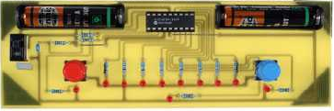
The 16F84A Microcontroller: Pin Connection Diagram
The 16F84A is available as an 18-pin device. The pin connection diagram is shown here. This won’t make much sense just yet, but in the coming sessions you will be surprised how quickly you get to know what most (if not all) of these pins are used for. In the book, the 16F84A is used as an example in an electronic ping-pong game.

Slide 8
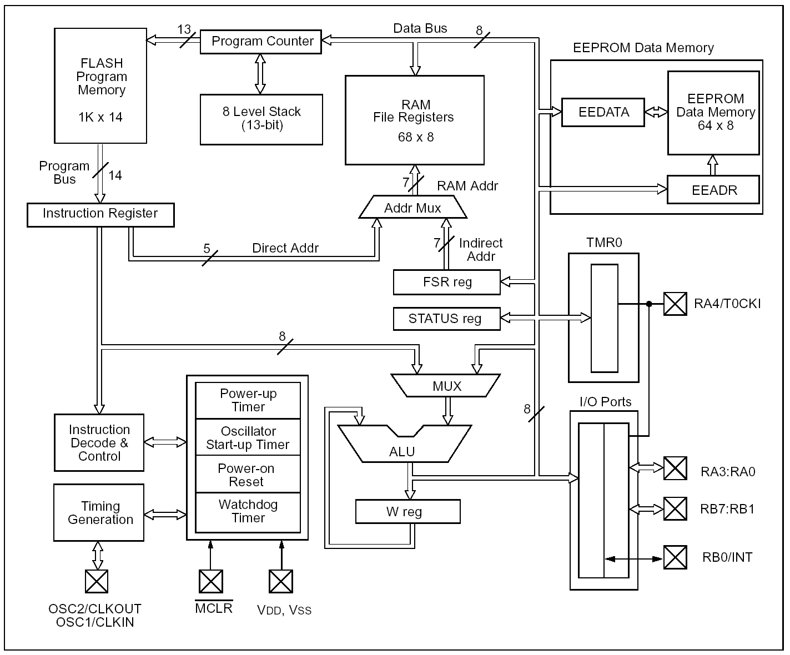
The PIC 16F84A Block Diagram
We are going to look at the block diagram of the 16F84A, straight from the manufacturer’s data sheet, shown below right. A good understanding of the block diagram leads to an ability to design with the microcontroller, and to program it. In the diagram, you should in time be able to recognise all the basic features of a microcontroller, as shown in the previous slide set, and repeated below left. Let’s pick out the main features of the 16F84A, in the coming slides.

Slide 9
The 16F84A Block Diagram – the main features
Extra “non-volatile” Data Memory
Address for Program Memory
Data Memory
Program Memory
Data from Program Memory, carrying instruction word
Address for Data Memory
Data bus for Data Memory and peripherals
It is easy to see the Program memory, which uses Flash memory technology. Alongside this comes the Stack, which we meet later. Microchip call the main data memory “File Registers”. There is another section of data memory which uses EEPROM technology.
Counter/Timer Peripheral
Digital Input/ Output Ports
The CPU

Slide 10
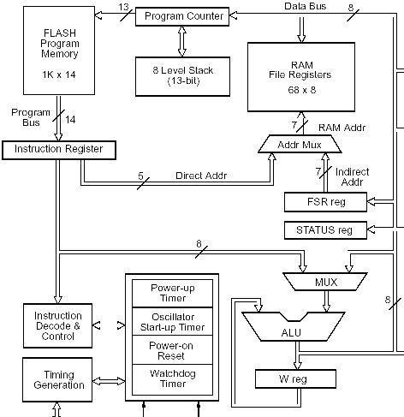
The 16F84A Core and Instruction Flow
The Instruction word
flows here. The word will contain the instruction, and maybe also address and data information
Address info. flows here
“Literal” data flows along here
Instruction info flows here
The core is the “microprocessor inside the microcontroller”, centred around the ALU. It is interesting to see the path that the instruction takes from program memory.
The Arithmetic Logic Unit
The “Working Register”

Slide 11
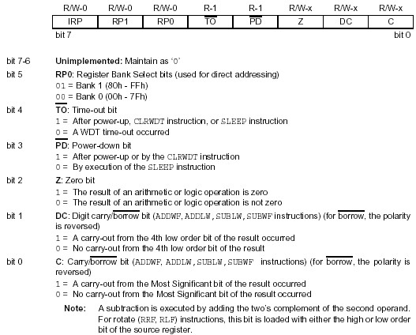
The Status Register
Condition Code Flags

Slide 12
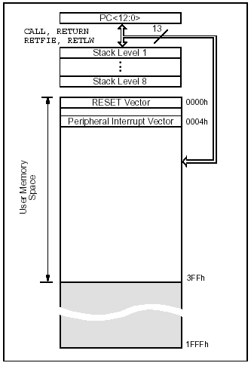
Program Memory and Stack
Program Counter
16 Series instructions which invoke the Stack
The program must start here
The Interrupt Service Routine must start here
Program Counter points to locations in program memory
Unimplemented memory space, still addressable by the 13-bit 16F84A program address bus.

Slide 13
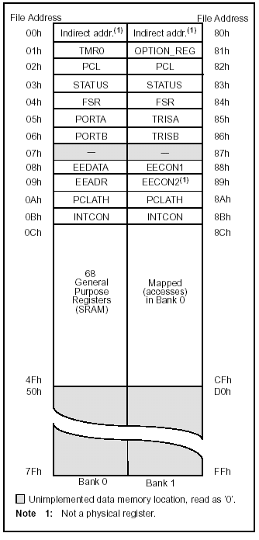
Data Memory and Special Function Register Map
These are the Special Function Registers, which allow the CPU to interact with the peripherals
msb is “bank select bit”
(Status register).
General purpose memory

Slide 14
Interfacing with Peripherals – the Special Function Register
Microcontroller Interaction with its Peripherals, via Special Function Register (SFR) and Interrupt
    microcontroller peripherals can be configured in software to operate in a number of different modes, to do this certain control data must be sent to them to set them up in the desired way
    once in use, there will be data flow between core and peripheral,
    there may still be need for further control data,
    these needs are commonly met by means of dedicated, memory - mapped registers, sometimes called Special Function Registers,
    this approach gives the microcontroller manufacturer great flexibility to extend a microcontroller family – SFRs for new peripherals can easily be located in gaps in the memory map.

Slide 15
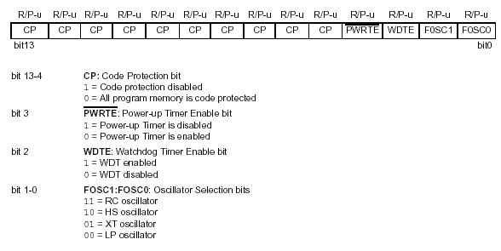
The 16F84A Configuration Word
The configuration word determines certain operating features of the microcontroller. It is in program memory, but cannot be accessed in normal operation. It is written to during the programming process. You set its value either by response to a dialogue box in MPLAB, or by use of Assembler Directives, at the head of your programme.

Slide 16
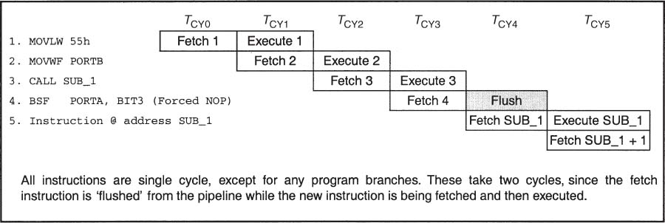
Instruction Pipelining

Slide 17
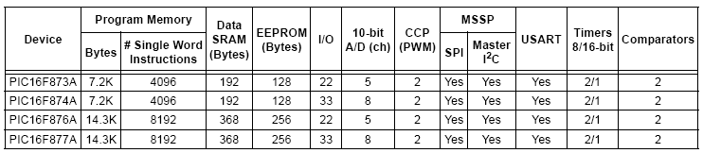
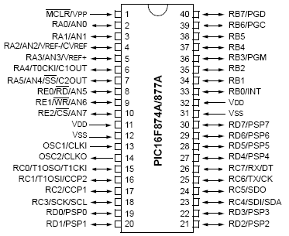
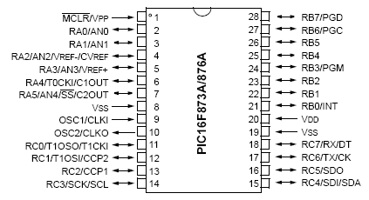
The 16F87XA Microcontroller - Some Overview Information
The 16F873A is one of a group of 4 very similar 16 Series PIC microcontrollers. It comes in the smaller of two package sizes, and has the smallest memory.

Slide 18
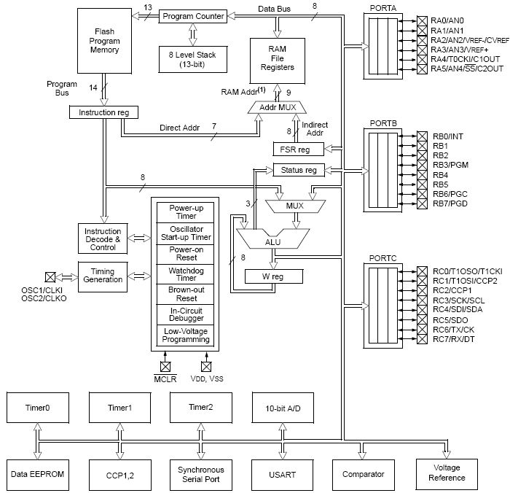
The PIC 16F873A Block Diagram
As a direct “big brother” of the 16F84A, it should be possible to recognise all the features of the smaller device in the larger 16F873A.

Slide 19
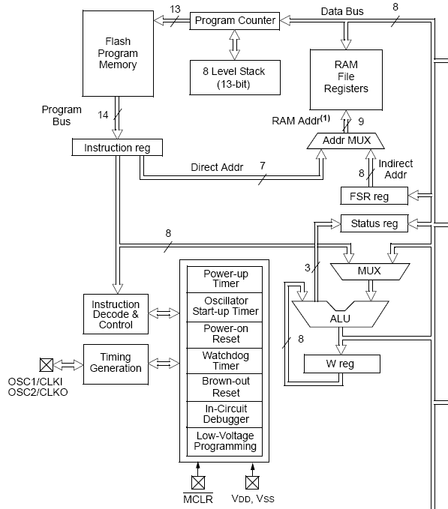
The 16F873A Core
Address for Data memory generated here
The Instruction word flows along here. The Instruction word may contain instruction, address and data information
Data info flows along here
Address info flows along here
Instruction info flows along here
The CPU

Slide 20
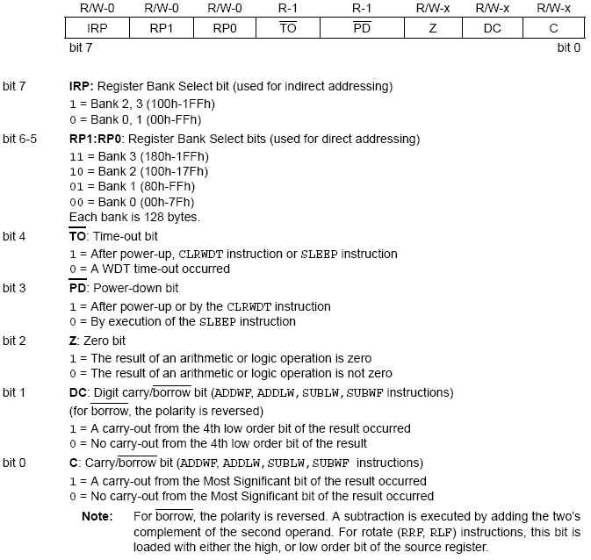
The Status Register

Slide 21
The Memory
Program Memory
Data Memory

Slide 22
The Peripherals
Parallel Ports
It is easy to see the peripherals, tho’ each one will take some work to understand. Connection to the peripherals goes through the parallel port bits. Most of these bits therefore have more than one use, which begins to explain why the names against them are not simple.
Serial Ports
Counter/Timers
Peripherals
Peripherals

Slide 23
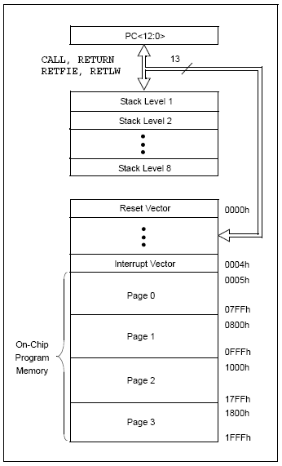
Program Memory
Instructions which access the Stack
Memory Address
Program always starts here
Interrupt Routine always starts here

Slide 24
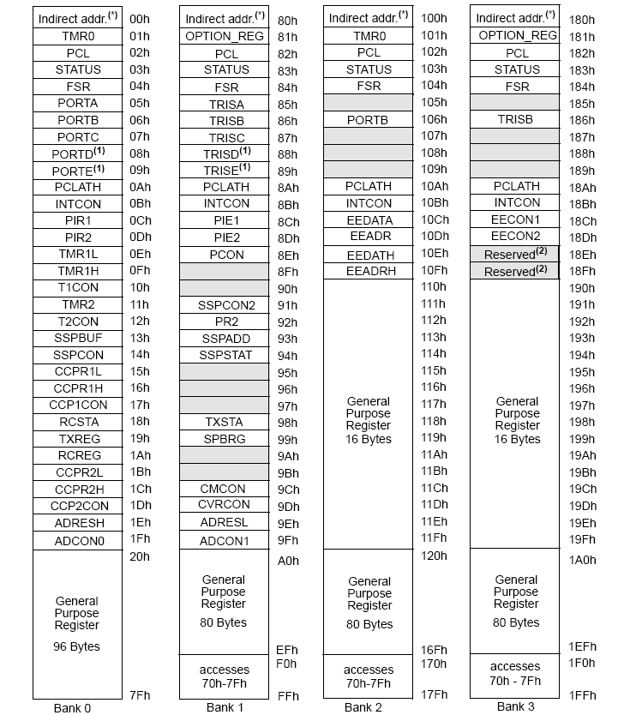
The Data Memory Map, including the Special Function Registers
Areas of immediate interest

Slide 25
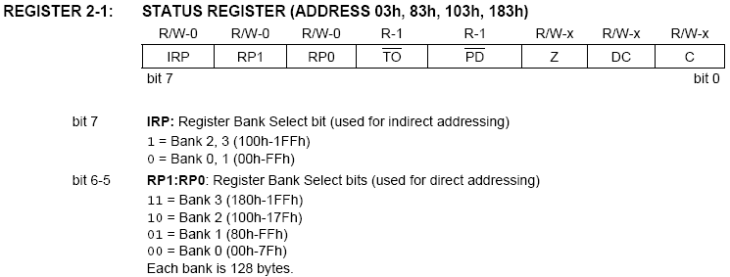
Understanding the Banked Addressing

Slide 26
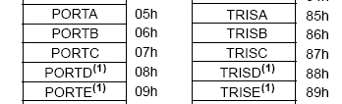
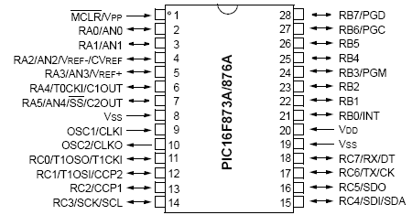
Parallel Input/Output Ports 4
SFRs for the 16F873A Parallel Ports
The SFR named PORTX holds the input/output data for the port, ie it holds all the “Data Latch” bits for that port.
The SFR named TRISX holds all the “TRIS Latch” bits for that port. The bits can be set independently, so one can be input while another output. They cannot be both at the same time.
Port A, B and C pin connections can easily be found on the pin diagram. Note that many pins have several functions, as indicated on the diagram.

Slide 27
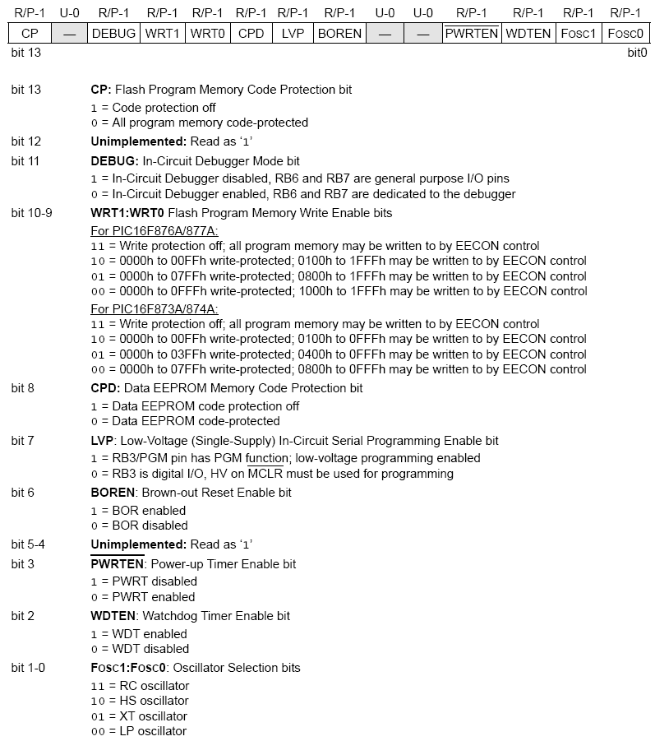
The 16F873A Configuration Word

Slide 28

ARM - Acorn RISC Machine, Advanced RISC Machine

Slide 29
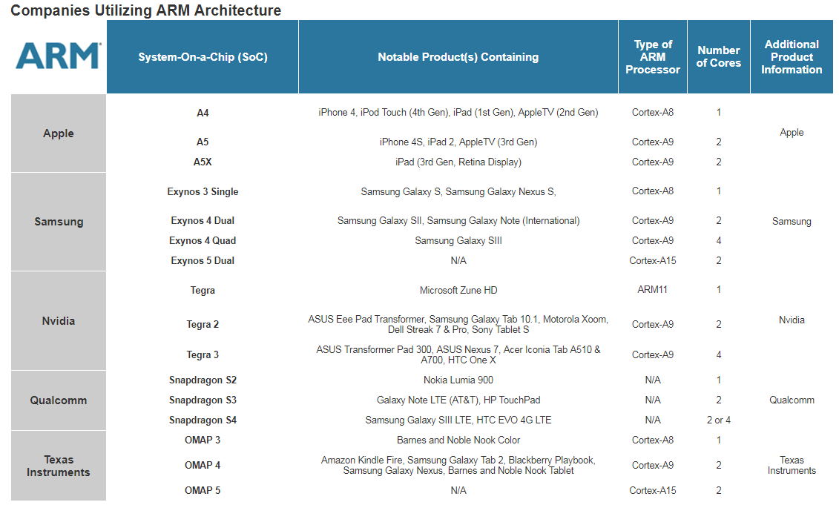

Slide 30
Summary
The PIC mid-range is a diverse and effective family of microcontrollers.
The 16F84A architecture is representative of all mid-range microcontrollers, with Harvard structure, pipelining and a RISC instruction set.
The PIC 16F84A has a limited set of peripherals, chosen for small and low-cost applications. It is thus a smaller member of the family, with features that are a subset of any of the larger ones.
The 16F84A uses three distinct memory technologies for its different memory areas.
A particular type of memory location is the Special Function Register, which acts as the link between the CPU and the peripherals.
Reset mechanisms ensure that the CPU starts running when the appropriate operating conditions have been met, and can be used to restart the CPU in case of program failure.
End of Lecture

